Slide 1

Working with Abstraction
Architecture, Refactoring and Enumerations
SoftUni Team
Technical Trainers
Software University
https://softuni.bg

Slide 2
Have a Question?
sli.do
#java-advanced

Slide 3
Table of Contents
Project Architecture
Methods
Classes
Projects
Code Refactoring
Enumerations
Static Keyword
Java Packages

Slide 4

Project Architecture

Slide 5
Splitting Code into Methods (1)
We use methods to split code into functional blocks
Improves code readability
Allows for easier debugging
for (char move : moves){
for (int r = 0; r < room.length; r++)
for (int c = 0; c < room[r].length; c++)
if (room[row][col] == 'b')
…
}
for (char move : moves) {
moveEnemies();
killerCheck();
movePlayer(move);
}

Slide 6
Splitting Code into Methods (2)
Methods let us easily reuse code
We change the method once to affect all calls
BankAccount bankAcc = new BankAccount();
bankAcc.setId(1);
bankAcc.deposit(20);
System.out.printf("Account %d, balance %d",
bankAcc.getId(),bankAcc.getBalance());
bankAcc.withdraw(10);
…
System.out.println(bankAcc.toString());
Override .toString() to set a global printing format

Slide 7


Splitting Code into Methods (3)
A single method should complete a single task
void doMagic ( … )
void depositOrWithdraw ( … )
BigDecimal depositAndGetBalance ( … )
String parseDataAndReturnResult ( … )
void withdraw ( … )
void deposit ( … )
BigDecimal getBalance ( … )
string toString ( … )

Slide 8
Problem: Rhombus of Stars
Draw on the console a rhombus of stars with size n
n = 3
n = 2
n = 1
*
* *
* * *
* *
*
*
* *
*
*
Check your solution here: https://judge.softuni.bg/Contests/1575/Working-with-Abstraction-Lab

Slide 9
Solution: Rhombus of Stars (1)
int size = Integer.parseInt(sc.nextLine());
for (int starCount = 1; starCount <= size; starCount++) {
printRow(size, starCount);
}
for (int starCount = size - 1; starCount >= 1; starCount--) {
printRow(size, starCount);
}
Reusing code
Check your solution here: https://judge.softuni.bg/Contests/1575/Working-with-Abstraction-Lab

Slide 10
Solution: Rhombus of Stars (2)
static void printRow(int figureSize, int starCount) {
for (int i = 0; i < figureSize - starCount; i++)
System.out.print(" ");
for (int col = 1; col < starCount; col++) {
System.out.print("* ");
}
System.out.println("*");
}
Check your solution here: https://judge.softuni.bg/Contests/1575/Working-with-Abstraction-Lab

Slide 11
Splitting Code into Classes (1)
Just like methods, classes should not know or do too much
GodMode master = new GodMode();
int[] numbers = master.parseAny(input);
...
int[] numbers2 = master.copyAny(numbers);
master.printToConsole(master.getDate());
master.printToConsole(numbers);
11

Slide 12
Splitting Code into Classes (2)
We can also break our code up logically into classes
Hiding implementation
Allow us to change the output destination
Helps us to avoid repeating code

Slide 13
Splitting Code into Classes (3)
List<Integer> input = Arrays.stream(
sc.nextLine().split(" "))
.map(Integer::parseInt)
.collect(Collectors.toList());
...
String result = input.stream()
.map(String::valueOf)
.collect(Collectors.joining(", "));
System.out.println(result);
ArrayParser parser = new ArrayParser();
OuputWriter printer = new OuputWriter();
int[] numbers = parser.integersParse(args);
int[] coordinates = parser.integerParse(args1);
printer.printToConsole(numbers);

Slide 14
Problem: Point in Rectangle
Create a Point class holding the horizontal and vertical coordinates
Create a Rectangle class
Holds 2 points
Bottom left and top right
Add Contains method
Takes a Point as an argument
Returns it if it’s inside the current object of the Rectangle class
Check your solution here: https://judge.softuni.bg/Contests/1575/Working-with-Abstraction-Lab

Slide 15
Solution: Point in Rectangle
public class Point {
private int x;
private int y;
//TODO: Add getters and setters
}
public class Rectangle {
private Point bottomLeft;
private Point topRight;
//TODO: getters and setters
public boolean contains(Point point) {
//TODO: Implement
}
}
Check your solution here: https://judge.softuni.bg/Contests/1575/Working-with-Abstraction-Lab

Slide 16
Solution: Point in Rectangle (2)
public boolean contains(Point point)
{
boolean isInHorizontal =
this.bottomLeft.getX() <= point.getX() &&
this.topRight.getX() >= point.getX();
boolean isInVertical =
this.bottomLeft.getY() <= point.getY() &&
this.topRight.getY() >= point.getY();
boolean isInRectangle = isInHorizontal && isInVertical;
return isInRectangle;
}
Check your solution here: https://judge.softuni.bg/Contests/1575/Working-with-Abstraction-Lab

Slide 17

Refactoring

Slide 18
Refactoring
Restructures code without changing the behaviour
Improves code readability
Reduces complexity
class ProblemSolver { public static void doMagic() { … } }
class CommandParser {
public static <T> Function<T, T> parseCommand() { … } }
class DataModifier { public static <T> T execute() { … } }
class OutputFormatter { public static void print() { … } }
18

Slide 19
Refactoring Techniques
Breaking code into reusable units
Extracting parts of methods and classes into new ones
deposit()
withdraw()
depositOrWithdraw()
Improving names of variables, methods, classes, etc.
String str;
String name;
Moving methods or fields to more appropriate classes
Car.open()
Door.open()

Slide 20
Problem: Student System
You are given a working Student System project to refactor
Break it up into smaller functional units and make sure it works
It supports the following commands:
"Create {studentName} {studentAge} {studentGrade}"
creates a new student
"Show {studentName}"
prints information about a student
"Exit"
closes the program
Check your solution here: https://judge.softuni.bg/Contests/1575/Working-with-Abstraction-Lab

Slide 21
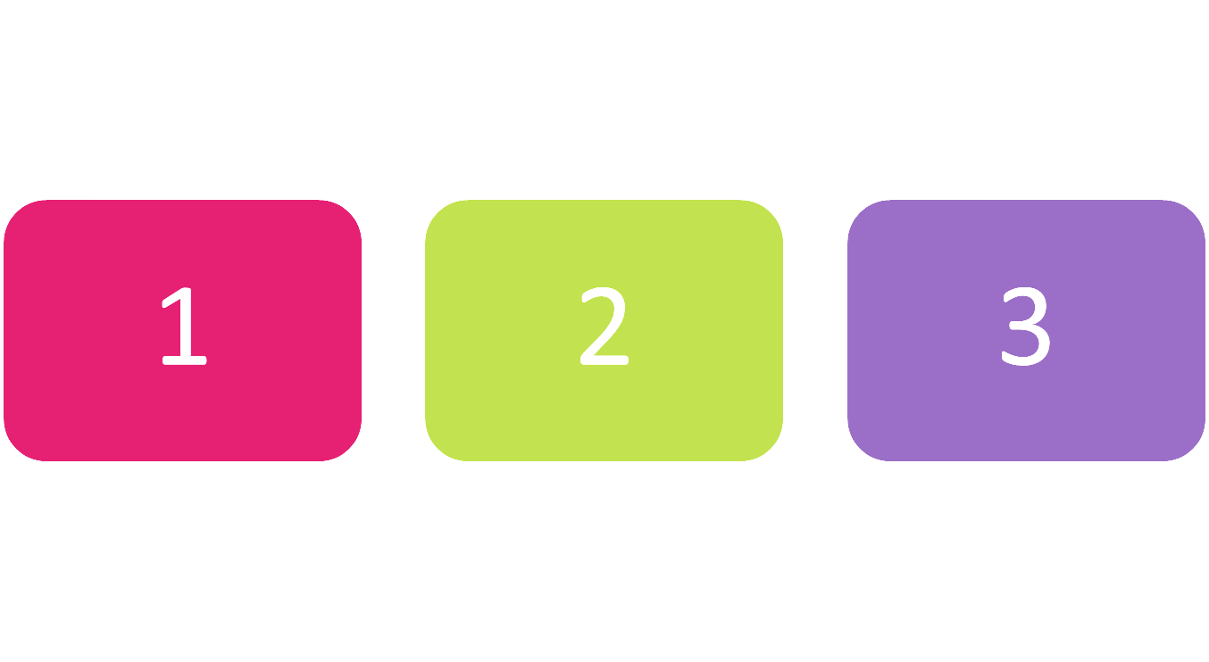
Enumerations

Slide 22
Enumerations
Represent a numeric value from a fixed set as a text
We can use them to pass arguments to methods without making code confusing
By default, enums start at 0
Every next value is incremented by 1
enum Day {Mon, Tue, Wed, Thu, Fri, Sat, Sun}
GetDailySchedule(0)
GetDailySchedule(Day.Mon)
22

Slide 23



Enumerations (1)
We can customize enum values
enum Day {
Mon(1),Tue(2),Wed(3),Thu(4),Fri(5),Sat(6),Sun(7);
private int value;
Day(int value) {
this.value = value;
}
}
System.out.println(Day.Sat); // Sat

Slide 24
Enumerations (2)
We can customize enum values
enum CoffeeSize {
Small(100), Normal(150), Double(300);
private int size;
CoffeeSize(int size) {
this.size = size;
}
public int getValue() { return this.size; }
}
System.out.println(CoffeeSize.Small.getValue()); // 100

Slide 25

Problem: Hotel Reservation
Create a class PriceCalculator that calculates the total price of a holiday, by given price per day, number of days, the season and a discount type
The discount type and season should be enums
The price multipliers will be:
1x for Autumn, 2x for Spring, etc.
The discount types will be:
None – 0%
SecondVisit – 10%
VIP – 20%
Check your solution here: https://judge.softuni.bg/Contests/1575/Working-with-Abstraction-Lab

Slide 26
Solution: Hotel Reservation (1)
public enum Season {
Spring(2), Summer(4), Autumn(1), Winter(3);
private int value;
Season(int value) {
this.value = value;
}
public int getValue() {
return this.value;
}
}
Check your solution here: https://judge.softuni.bg/Contests/1575/Working-with-Abstraction-Lab

Slide 27
Solution: Hotel Reservation (2)
public enum Discount {
None(0), SecondVisit(10), VIP(20);
private int value;
Discount(int value) {
this.value = value;
}
public int getValue() {
return this.value;
}
}
Check your solution here: https://judge.softuni.bg/Contests/1575/Working-with-Abstraction-Lab

Slide 28
Solution: Hotel Reservation (3)
public class PriceCalculator {
public static double CalculatePrice(double pricePerDay,
int numberOfDays, Season season, Discount discount) {
int multiplier = season.getValue();
double discountMultiplier = discount.getValue() / 100.0;
double priceBeforeDiscount = numberOfDays * pricePerDay * multiplier;
double discountedAmount = priceBeforeDiscount * discountMultiplier;
return priceBeforeDiscount - discountedAmount;
}
}
Check your solution here: https://judge.softuni.bg/Contests/1575/Working-with-Abstraction-Lab

Slide 29

Static Keyword in Java

Slide 30
Static Keyword
Used for memory management mainly
Can apply with:
Nested class
Variables
Methods
Blocks
Belongs to the class than an instance of the class
static int count;
static void increaseCount() {
count++;
}
30

Slide 31
Static Class
A top level class is a class that is not a nested class
A nested class is any class whose declaration occurs within the body of another class or interface
Only nested classes can be static
class TopClass {
static class NestedStaticClass {
}
}
31

Slide 32
Static Variable
Can be used to refer to the common variable of all objects
Example
The company name of employees
College name of students
The name of the college is common for all students
Allocate memory only once in the class area at the time of class loading
32

Slide 33
Example: Static Variable (1)
class Counter {
int count = 0; static int staticCount = 0;
public Counter() {
count++; // incrementing value
staticCount++; // incrementing value
}
public void printCounters() {
System.out.printf("Count: %d%n", count);
System.out.printf("Static Count: %d%n", staticCount);
}
}
33

Slide 34
Example: Static Variable (2)
// Inside the Main Class
public static void main(String[] args) {
Counter c1 = new Counter();
c1.printCounters();
Counter c2 = new Counter();
c2.printCounters();
Counter c3 = new Counter();
c3.printCounters();
int counter = Counter.staticCount; // 3
}
Count: 1
Static Count: 1
Count: 1
Static Count: 2
Count: 1
Static Count: 3
34

Slide 35
Static Method
Belongs to the class rather than the object of a class
Can be invoked without the need for creating an instance of a class
Can access static data member and can change the value of it
Can not use non-static data member or call a non-static method directly
this and super cannot be used in a static context
35

Slide 36
Example: Static Method
class Calculate {
static int cube(int x) { return x * x * x; }
public static void main(String args[]) {
int result = Calculate.cube(5);
System.out.println(result); // 125
System.out.println(Math.pow(2, 3)); // 8.0
}
}
36

Slide 37
Static Block
A set of statements, which will be executed by the JVM before execution of the main method
Executing static block is at the time of class loading
A class can take any number of the static block but all blocks will be executed from top to bottom
37

Slide 38
Example: Static Block
class Main {
static int n;
public static void main(String[] args) {
System.out.println("From main");
System.out.println(n);
}
static {
System.out.println("From static block");
n = 10;
}
}
From static block
From main
10
38

Slide 39

Packages

Slide 40
Packages in Java
Used to group related classes
Like a folder in a file directory
Use packages to avoid name conflicts and to write a better maintainable code
Packages are divided into two categories:
Built-in Packages (packages from the Java API)
User-defined Packages (create own packages)
40

Slide 41
Build-In Packages
The library is divided into packages and classes
Import a single class or a whole package that contain all the classes
To use a class or a package, use the import keyword
The complete list can be found at Oracles website: https://docs.oracle.com/en/java/javase/
import package.name.Class; // Import a single class
import package.name.*; // Import the whole package
41

Slide 42

Summary
…
…
…
Well organized code is easier to work with
We can reduce complexity using Methods, Classes and Projects
We can refactor existing code by breaking code down
Enumerations define a fixed set of constants
Represent numeric values
We can easily cast enums to numeric types
Static members and Packages

Slide 43
Questions?
Notes:
43

Slide 44














SoftUni Diamond Partners

Slide 45

Educational Partners

Slide 46
Trainings @ Software University (SoftUni)
Software University – High-Quality Education, Profession and Job for Software Developers
softuni.bg
Software University Foundation
softuni.foundation
Software University @ Facebook
facebook.com/SoftwareUniversity
Software University Forums
forum.softuni.bg
46
Notes:
46

Slide 47

License
This course (slides, examples, demos, exercises, homework, documents, videos and other assets) is copyrighted content
Unauthorized copy, reproduction or use is illegal
© SoftUni – https://about.softuni.bg
© Software University – https://softuni.bg
Notes:
47

